Slide 1
Celestial Coordinate System & Telescopes
Tanveer Karim,
Banneker & Aztlán Institute and Harvard University
Day – 1, 25 June 2018

Slide 2
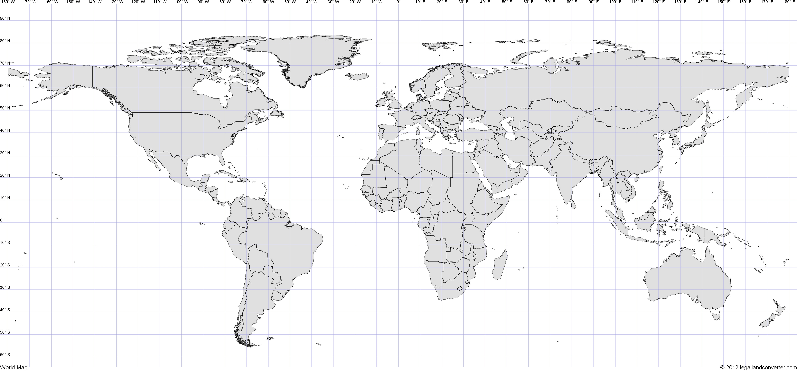

Slide 3
Task 1: Sexa2Dec.py
Keep degree value intact
Divide arcminute by 60 and store the value
Divide arcsecond by appropriate constant and store the value
Add the values together and return it
Notes:
See the Programming Worksheet for more information

Slide 4

Hand Measurement of Angles

Slide 5
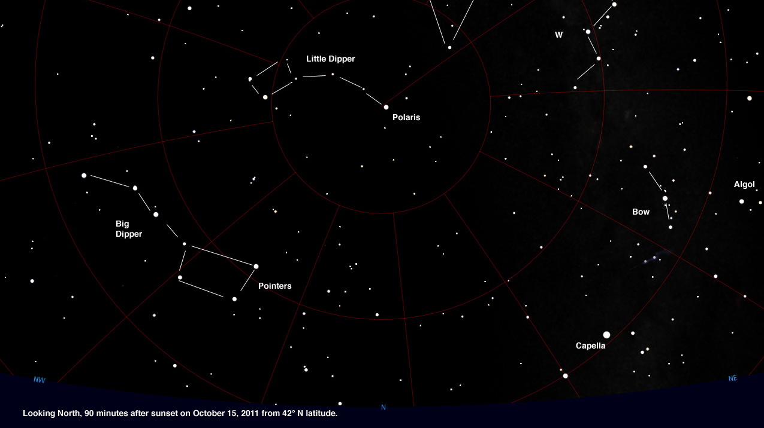
Image Credit: astrojourney.wordpress.com

Slide 6
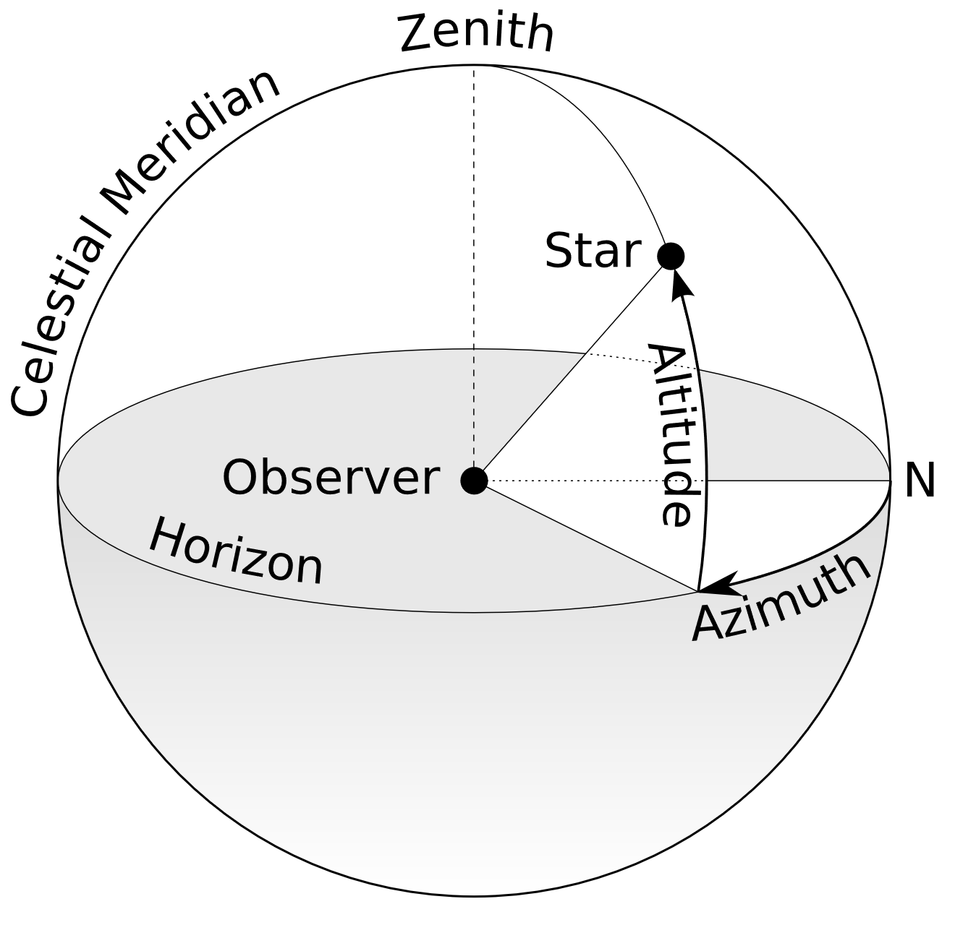
Horizontal Coordinate System

Slide 7
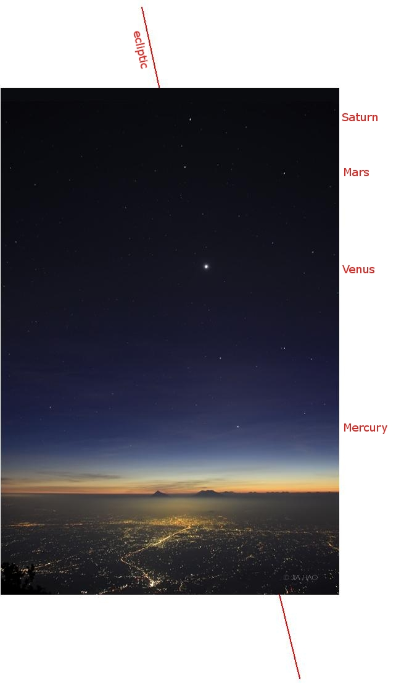
Notes:
Planets aligned near the Ecliptic

Slide 8
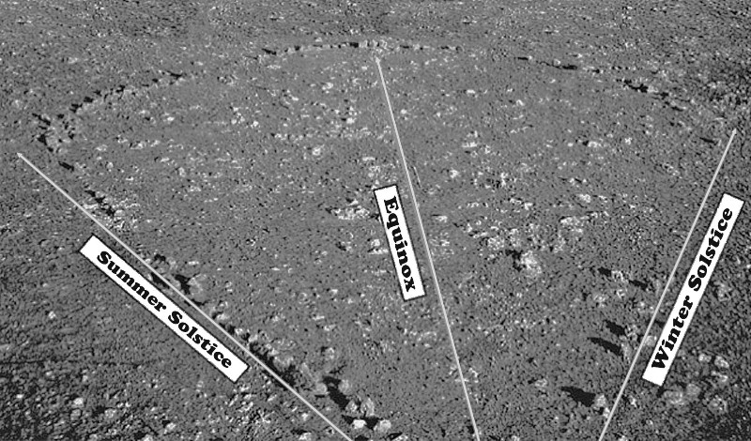
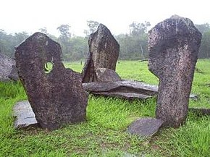
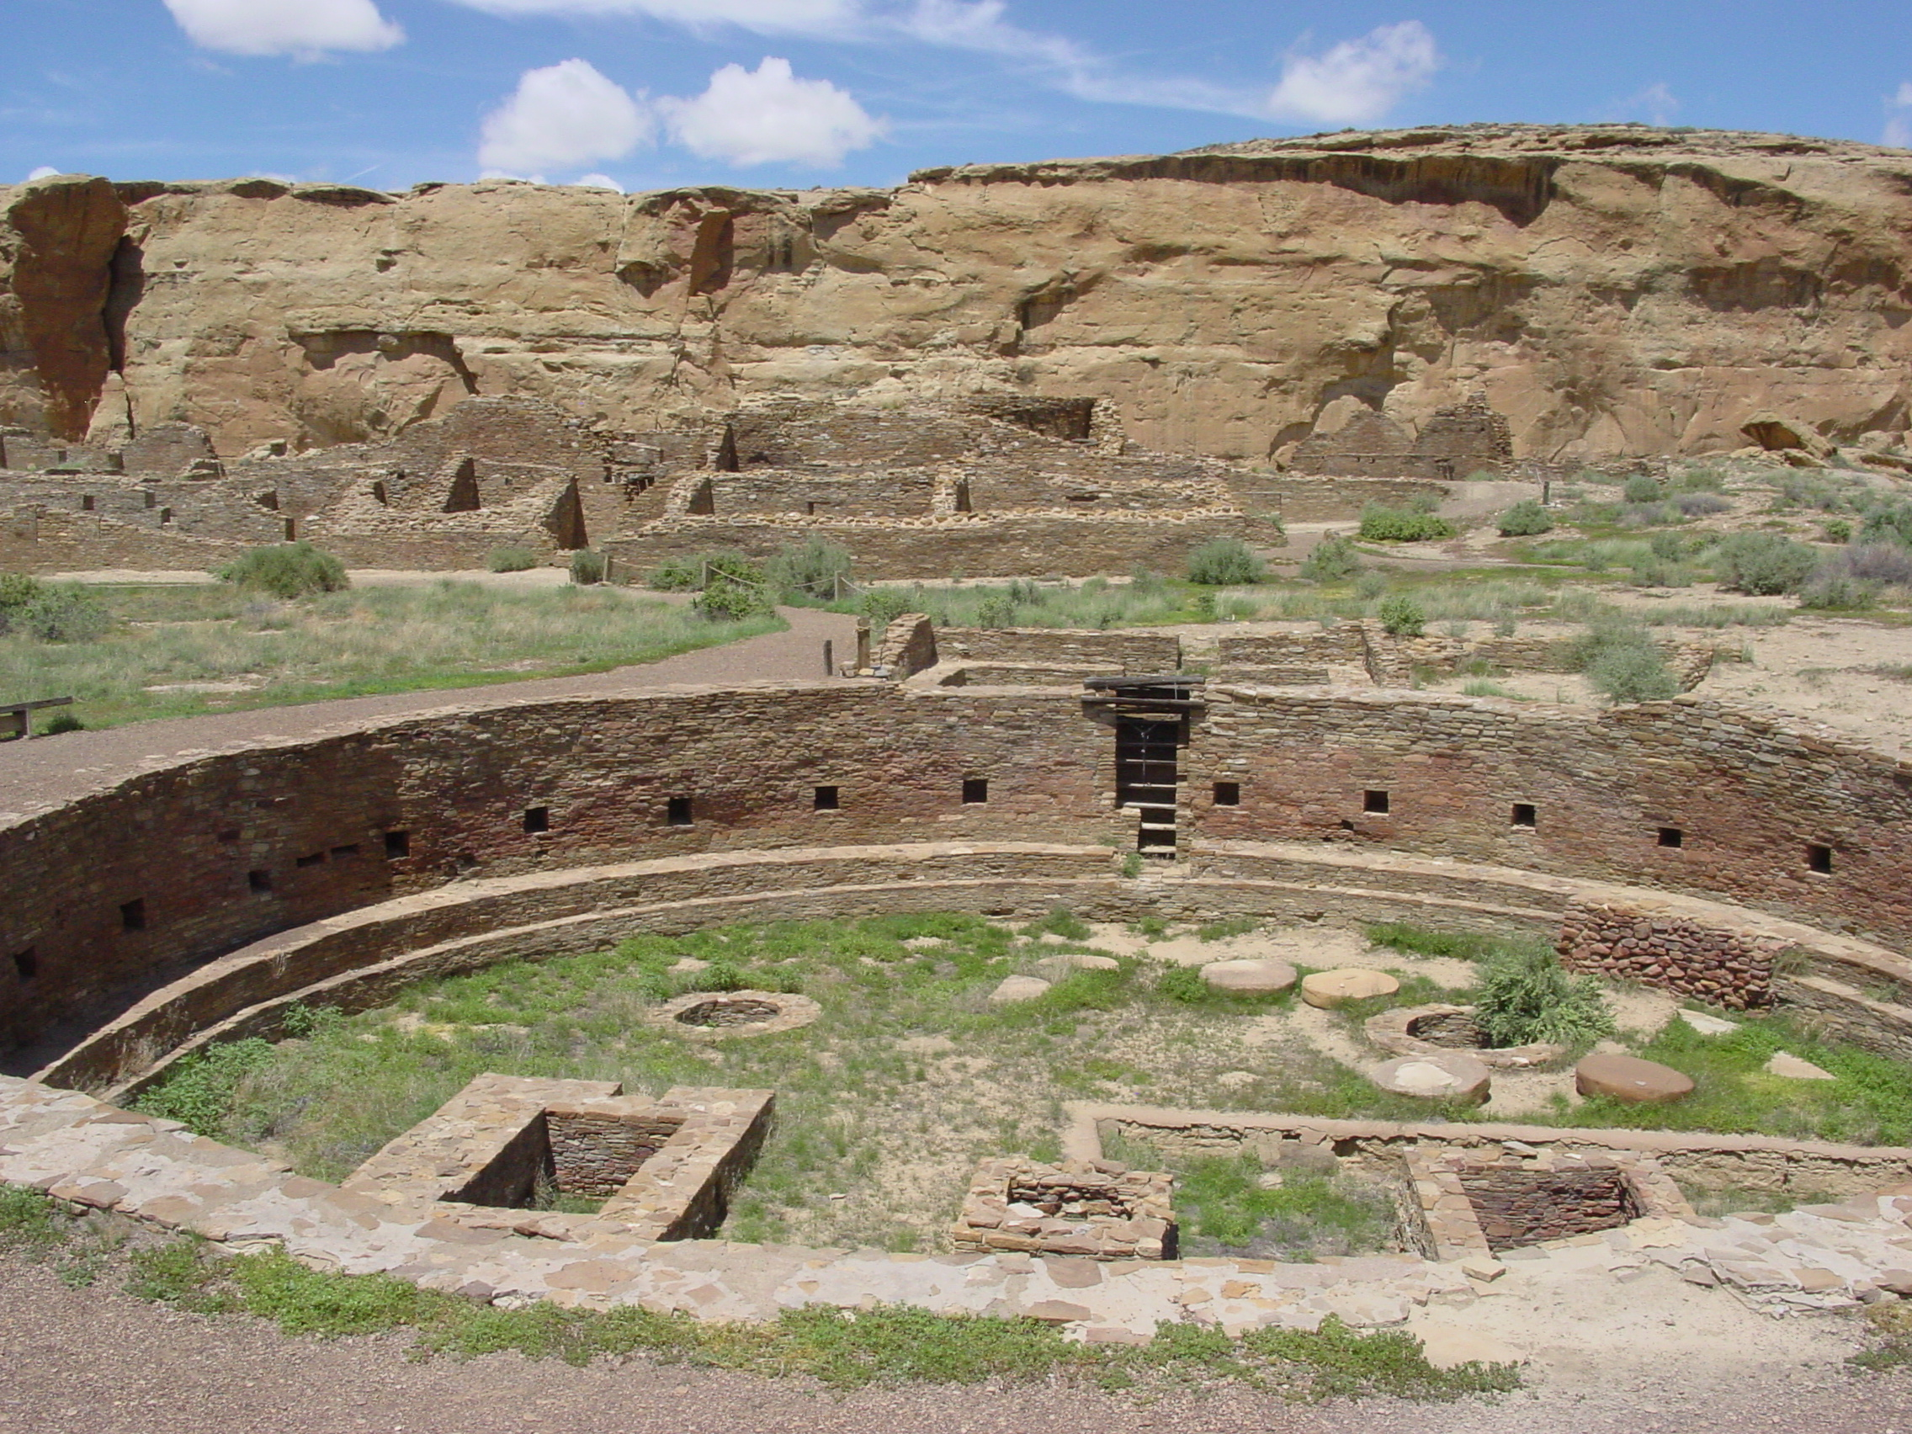
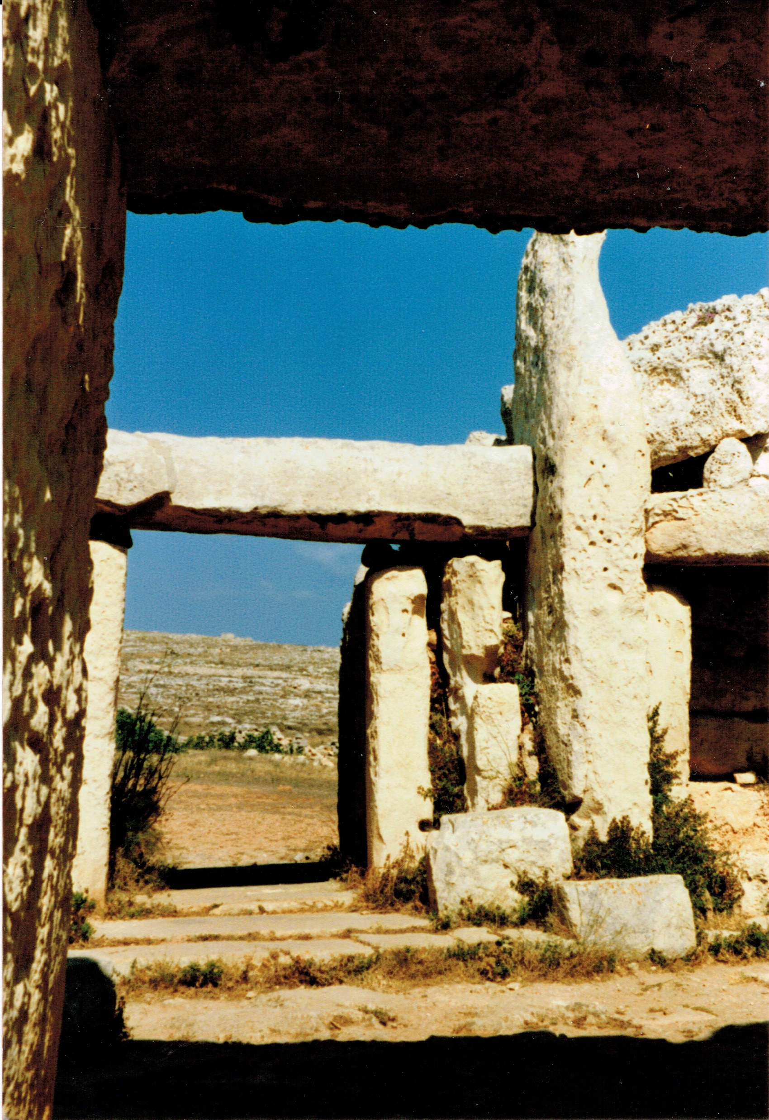
poi-australia.com.au
Wikipedia
Wikipedia
Wikipedia
Notes:
*Wurdi Youang – 11,000 years old aboriginal observatory
*Amazon Stonehenge – 500-2000 years old Brazil Rego Grande basin
*Megalithic Temples of Malta – 3100 BC
*Chaco Culture National Historical Park – Ancient Pueblo People 900-1150 AD

Slide 9
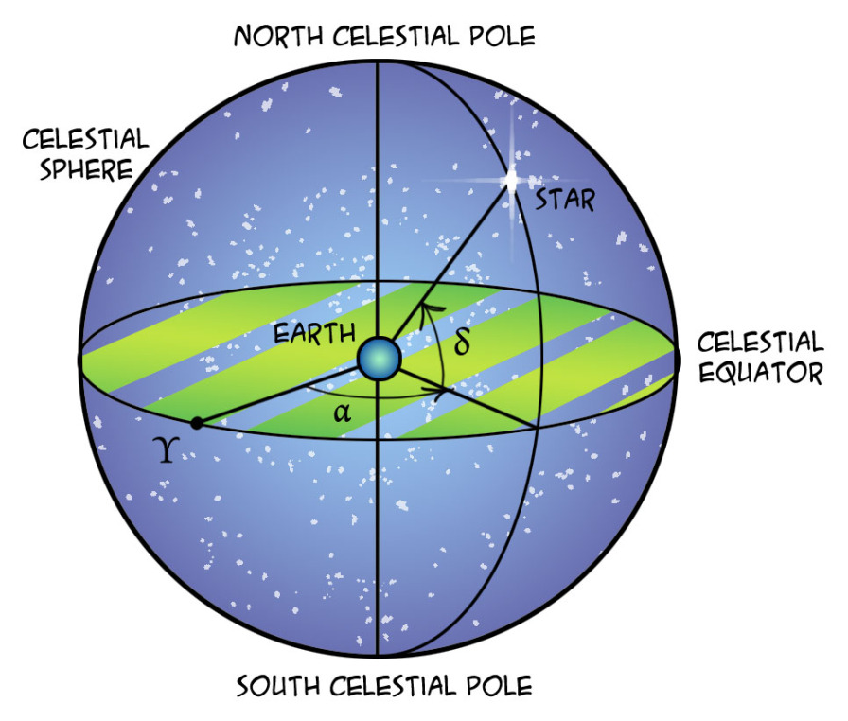
Equatorial Coordinate System
quantumredpill.wordpress.com

Slide 10
Task 3: Astro Scavenger Hunt!
Let’s try to find the following stars:
Sirius – 06h45m09s, -16d42m58s
Canopus – 06h23m57s, -52d41m44s
Go to http://simbad.u-strasbg.fr/simbad/sim-fbasic and find your favourite star!
Which stars are in these coordinates?
14h15m40s, +19d10m57s
12h26m36, -63d05m5s

Slide 11
Task 3: Astro Scavenger Hunt!
Let’s try to find the following stars:
Sirius – 06h45m09s, -16d42m58s
Canopus – 06h23m57s, -52d41m44s
Go to http://simbad.u-strasbg.fr/simbad/sim-fbasic and find your favourite star!
Which stars are in these coordinates?
14h15m40s, +19d10m57s – Arcturus
12h26m36, -63d05m5s – Acrux (brightest in the Southern Cross)

Slide 12
If you have any questions, clarifications or feedback, please feel free to fill out the following anonymous survey:
https://goo.gl/X3hCmP

